Slide 1
Psychoanalytic Perspective
Sigmund Freud
and
Defense Mechanism

Slide 2
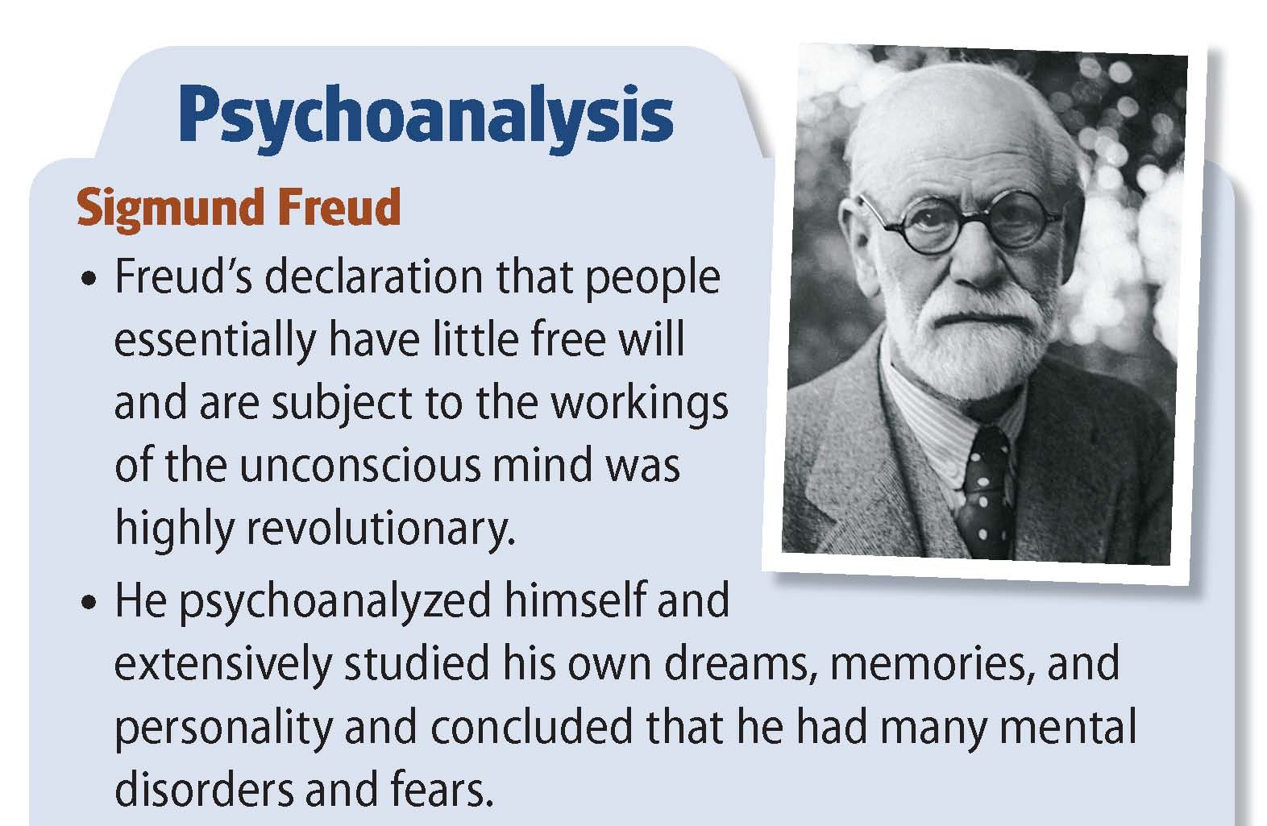

Slide 3
Sigmund Freud and Psychoanalysis
He theorized that the key to human behavior is satisfying desires.
Freud was the most famous of the early psychologists.
He developed psychoanalysis, which emphasizes unconscious motives and internal conflicts in human behavior.
He developed psychodynamic thinking, which assumes that most of what exists in an individual's mind is unconscious and consists of conflicting impulses, urges, and wishes.

Slide 4
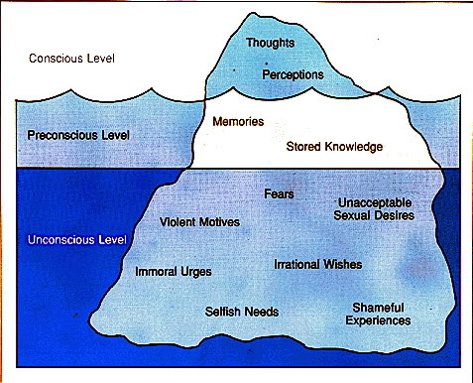
“Freud’s Iceberg”

Slide 5
Mind and Iceberg: Three levels of Mind
Conscious
Subconscious
Unconscious

Slide 6
Structure of Personality:
ID
Pleasure Principle
EGO
Reality Principle (Executive of Personality)
Superego
Moral Principles

Slide 7
Anxiety & Defense Mechanism

Slide 8
Basic Concept
In Sigmund Freud's topographical model of personality, the ego is the aspect of personality that deals with reality.
While doing this, the ego also has to cope with the conflicting demands of the id and the superego.

Slide 9
The id seeks to fulfill all wants, needs, and impulses while the superego tries to get the ego to act in an idealistic and moral manner.
What happens when the ego cannot deal with the demands of ones desires, the constraints of reality, and ones own moral standards?
Anxiety acts as a signal to the ego that things are not going right.

Slide 10
Basic concepts
Freud identified three different types of anxiety.
Reality Anxiety: This is the most basic form of anxiety and is typically based on fears of real and possible events, such as being bitten by a dog or falling from a ladder.
The most common way of reducing tension from Reality Anxiety is taking oneself away from the situation !

Slide 11
Neurotic Anxiety: This is a form of anxiety which comes from an unconscious fear that the basic impulses of the ID (the primitive part of our personality) will take control of the person, leading to eventual punishment(this is thus a form of Moral Anxiety).
Id x Ego: Neurotic Anxiety
Moral Anxiety: This form of anxiety comes from a fear of violating values and moral codes, and appears as feelings of guilt or shame.
Superego x Ego: Moral Anxiety

Slide 12
According to Freud, anxiety is an unpleasant inner state that people seek to avoid.
When anxiety occurs, the mind first responds by an increase in problem-solving thinking, seeking rational ways of escaping the situation.
If this is not fruitful (and maybe anyway), ego has some tools it…, tools that help defend the ego… these are called Ego Defense Mechanisms or Defenses.
They helped shield the ego from the conflicts created by the id, superego, and reality.

Slide 13
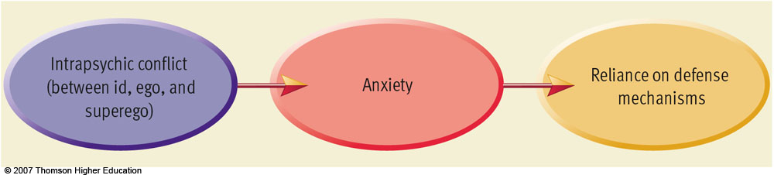

Slide 14
Denial: Arguing against an anxiety provoking stimuli by stating it doesn't exist.
Many people use denial in their everyday lives to avoid dealing with painful feelings or areas of their life they don’t wish to admit.
Examples:
1) Patient denies that his physician's diagnosis of cancer is correct and seeks a second opinion.
2) Alcoholics vigorously deny that they have a problem.
3) Cultural Perspective

Slide 15
Displacement: Taking out impulses on a less threatening target.
It occurs when the Id wants to do something of which the Super ego does not permit. The Ego thus finds some other way of releasing the psychic energy of the Id.
Thus there is a transfer of energy from a repressed object to a more acceptable object.

Slide 16
Displacements are often quite satisfactory and workable mechanisms for releasing energy more safely.
Examples:
1) The boss gets angry and shouts at a person. He goes home and shouts at his wife. She then shouts at their son. With nobody left to displace anger onto, he goes and kicks the dog.
2) A man wins the lottery. He turns to the person next to him and gives the person a big hug.

Slide 17
Intellectualization: “Flight into reason”. Avoiding unacceptable emotions by focusing on the intellectual aspects.
Intellectualization protects against anxiety by repressing the emotions connected with an event. It is also known as 'Isolation of affect' as the affective elements are removed from the situation.

Slide 18
Projection: Placing unacceptable impulses in yourself onto someone else.
Neurotic projection is perceiving others as operating in ways one unconsciously finds objectionable in yourself.
Complementary projection is assuming that others do, think and feel in the same way as you.

Slide 19
Rationalization: Supplying a logical or rational reason as opposed to the real reason.
When a person does something of which the moral super ego disapproves, then the ego seeks to defend itself by adding reasons that make the action acceptable to the super ego. Thus we are able to do something that is outside our values and get away with it without feeling too guilty.
Examples 1) A parent punishes a child and says that it is for the child's 'own good'.
2) A person evades paying taxes and then rationalizes it by talking about how the government wastes money (and how it is better for people to keep what they can).

Slide 20
Reaction Formation: Taking the opposite belief because the true belief causes anxiety.
It appears as a defense against a feared social punishment.
A common pattern in Reaction Formation is for the person to show ‘excessive behavior’.
Psychoanalysts believe that extreme patterns of Reaction Formation are found in paranoia and obsessive-compulsive disorder (OCD), where the person becomes trapped in a cycle of repeating a behavior that they know (at least at a deep level) is somehow wrong.

Slide 21
Regression: Returning to a previous stage of development.
Examples:
1) A person who suffers a mental breakdown assumes a fetal position, rocking and crying.
2) Emotional Tantrum
3) A patient makes childish demands and becomes dependent on the nurse for care that they could do for themselves.

Slide 22
Repression: Pulling into the unconscious.
The level of 'forgetting' in repression can vary from a temporary abolition of uncomfortable thoughts to a high level of amnesia, where events that caused the anxiety are buried very deep.
A high level of repression can cause a high level of anxiety or dysfunction, although this may also be caused by the repression of one particularly traumatic incident.

Slide 23
Sublimation: acting out unacceptable impulses in a socially acceptable way.
Sublimation is probably the most useful and constructive of the defense mechanisms as it takes the energy of something that is potentially harmful and turns it to doing something good and useful.
sublimating your aggressive impulses toward a career such as, boxer

Slide 24
Examples –
A angry man does pushups to work off his temper.
A person who has an obsessive need for control and order becomes a successful business entrepreneur.
Becoming a surgeon because of your desire to cut; lifting weights to release 'pent up' energy

Slide 25
Acting Out: The individual deals with emotional conflict or internal or external stressors by actions rather than reflections or feelings.
When a person acts out, it can act as a pressure release, and often helps the individual feel calmer and peaceful once again.
For instance, a child’s temper tantrum is a form of acting out when he or she doesn’t get his or her way with a parent. Self-injury may also be a form of acting-out, expressing in physical pain what one cannot stand to feel emotionally.

Slide 26
Important Characteristics
Defenses are a major means of managing impulse and affect
Defenses are unconscious
Defenses are discrete from one another
Although often the hallmarks of major psychiatric syndromes, defenses are dynamic and reversible;
Defenses can be adaptive as well as pathological.

Slide 27
The ego’s protective methods of reducing anxiety.
Ego defenses are not necessarily unhealthy as one thinks.
In fact, the lack of these defenses, or the inability to use them effectively can often lead to problems in life.
However, we sometimes employ the defenses at the wrong time or overuse them, which can be equally destructive.

Slide 28
Purpose of Defense Mechanisms
Defenses allow individuals a period of respite to master changes in self-image that cannot be immediately integrated, as might result from puberty, an amputation, or a promotion (i.e., changes in reality).
Defenses can deflect or deny sudden increases in biological drives. Awareness of instinctual wishes is usually diminished; alternatively, antithetical wishes may be passionately adhered to.

Slide 29
Defenses enable individuals to mitigate unresolved conflicts with important people, living or dead.
Finally, ego mechanisms of defense can keep anxiety, shame, and guilt within bearable limits during sudden conflicts with conscience and culture.

Slide 30
Outcomes of Mature Defenses
Excellent adjustment as an adult,
Happiness,
Job satisfaction,
Rich friendships/ relationships,
Fewer medical hospitalizations over life,
Better overall health,
A lower incidence of mental illness.

Slide 31
Outcomes of Immature Defenses:
Poor adjustment as an adult,
Higher divorce rates and marital discord,
Poor friendship/ relationship patterns,
Higher incidence of mental illness,
Greater number of sick leave days taken,
Poorer health generally

Slide 32
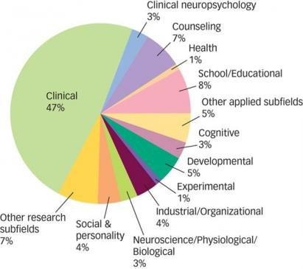
Subfields of Psychology

Slide 33
Subfields and Applications of Psychology
Developmental Psychology: Deals with how people change physically, cognitively, and socially across life span
Educational Psychology: Deals with all the aspects of educational process such as, mode of teaching and instruction, techniques of instruction, learning disability etc.
Cognitive Psychology: Deals with all the aspects of cognition such as, learning, memory, thinking, reasoning, decision making etc.

Slide 34
Environmental Psychology: Deals with the relationship between humans and the physical environment
Engineering Psychology: Deals with designing machines, products, services or tasks considering human limitations
Forensic Psychology: Deals with the possible association between psychopathology and criminal behaviour

Slide 35
Industrial/ Organizational Psychology: Studies all aspect of behaviour in organizational setup such as, how to improve the productivity of employees, training programme for employees, designing a system of performance appraisal
Psychobiology: Investigate the biological basis of behavior
Social Psychology: How social context affects the behavior of the individual and groups. It takes into account all aspects of social behaviour and and thought.

Slide 36
Experimental Psychology: Deals with all aspects of basic psychological processes such as, perception, learning, thinking, motivation etc.
Health or Medical Psychology: Aims to study the role of psychological factors in influencing and marinating physical health. It also emphasizes the promotion of good physical health
Abnormal Psychology: Deals with various forms of psychopathology
Clinical Psychology: Deals with the diagnosis and treatment of psychological disorders

